Slide 1
Zombie Apocalypse
How to prepare for the inevitable future.

Slide 2
Deciding a City for the Apocalypse
City venues are essential for deciding where to live prior to a zombie apocalypse
Different venues will be of greater use depending on the individual’s apocalypse strategy
Three different zombie apocalypse strategies
Survivalists
Those that want to survive in the city until a cure is found
Runners
Those that flee the city and go live in a bunker until it is over
Good Timers
Those that know it is the end and want a spectacular one

Slide 3
Apocalypse Strategies
Survivalists
Fortified place to stay
Ample food sources
Access to other supplies
Runners
Airports and train stations
Gas stations and car rental places
Access to food
Good Timers
Access to food
Many different entertainment venues

Slide 4
Data Analysis Strategy
Foursquare venue data collected for the five largest cities in the United States
The venues will be separated and categorized into the three apocalypse strategies and a food category that applies to all three strategies
Venues that do not fit into the four buckets will be excluded
Cities will be compared to determine the best cities for the three apocalypse strategies

Slide 5
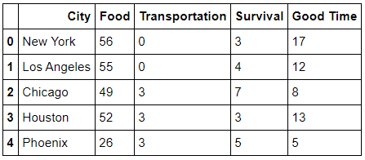
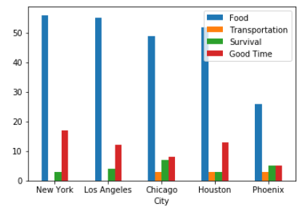
Compiled City Data

Slide 6
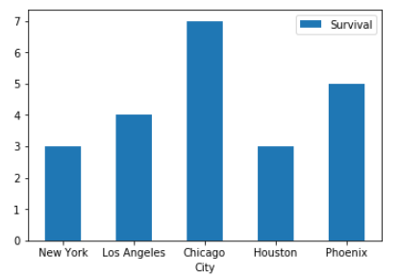
Chicago Best for Survival

Slide 7
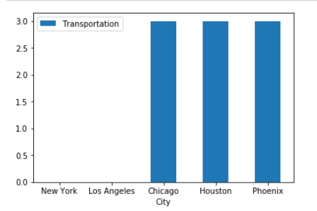
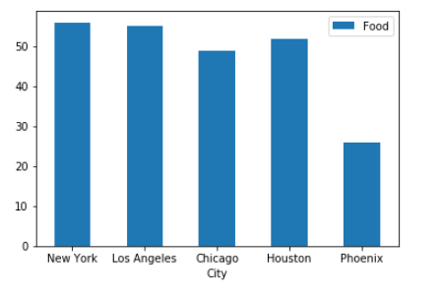
Houston Best for Runners

Slide 8
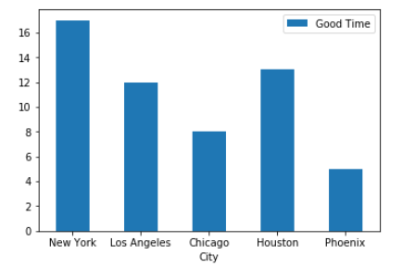
New York Best for a Good Time

Slide 9
Conclusions and Future Direction
Conclusions
Chicago is best for the survivalists
Houston is the best for the runners
New York is the best for the good timers
Los Angeles and Phoenix are good combinations of the apocalypse strategies
Future Direction
The program should be applied to several cities throughout the United States to see what cities are best suited for each strategy
Map of best running cities for the runners to go from one to another

